Slide 1


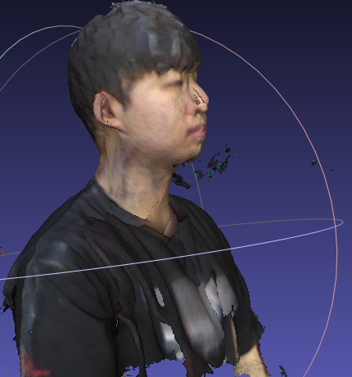
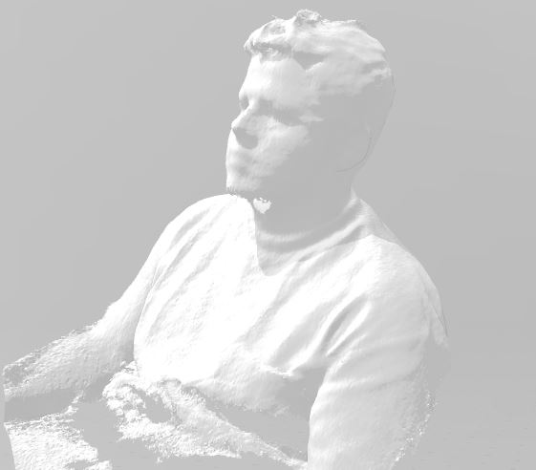
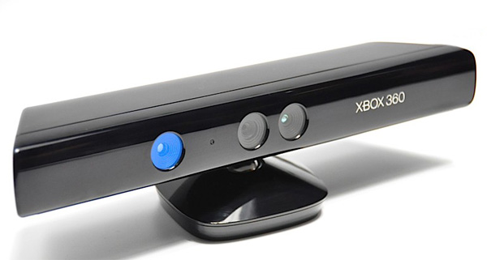
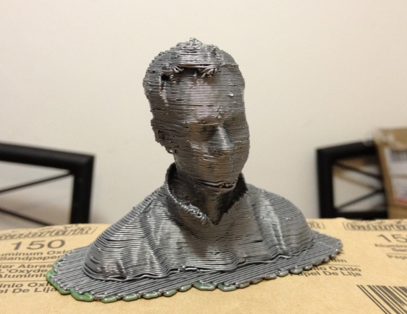
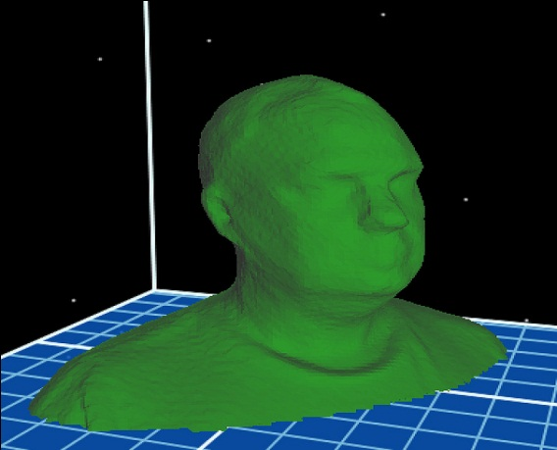
ReconstructMe: 3D Selfie
Dongseo University
Division of Computer & Information Engineering
Computer Vision - Prof: Lee Byung Gook
Mohammed Al-Absi

Slide 2
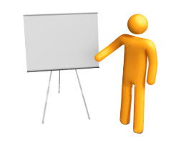

Outline
About Me
Educational Background
Research Interest
Introduction to VANET
My Current Research Topic
ReconstructMe
How to create a 3D Selfie
Considerations for generating selfies
Experiment – Selfies and Room
Self Rotation with Fixed Kinect
Kinect Rotation with Fixed object
Conclusion

Slide 3

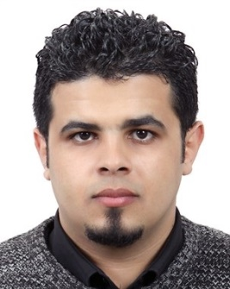
About Me
Name: Mohammed Alabsi
Country: Yemen- Arab Middle East
Hobbies: Traveling, reading, biking, cooking, hiking
Lab: Cryptography and Network Security Laboratory
Supervisor: Prof. HoonJae Lee

Slide 4
Educational Background
Bachelor’s Degree: Bangalore University, Bangalore – India
(Bachelor of Computer Application (B.C.A) )
Master’s Degree: Dongseo University- Korea
phD’s Degree: 2rd Sem - Dongseo University- Korea

Slide 5
Research Interest
My research interests focus on
VANET: V2V, V2I, Drone Ship building, security authentication method based on trust evaluation in VANETS, Dual Authentication.

Slide 6
Favorite Quotes
“Live as if you were to die tomorrow. Learn as if you were to live forever.”
Mahatma Gandhi
“You have to learn the rules of the game. And then you have to play better than anyone else.”
Albert Einstein
“Your time is limited, so don't waste it living someone else's life.”
Steve Jobs

Slide 7
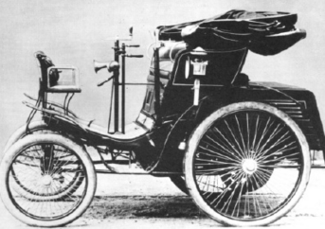
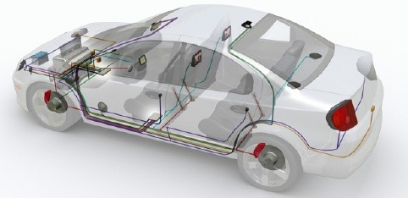
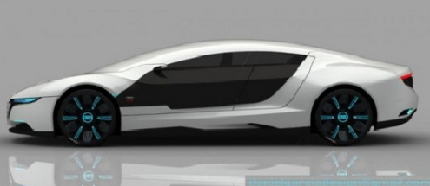
Introduction
Vehicles are the most popular means of transportation around the world.
Vehicles transformed into “Computers/Networks on the wheel” is called VANET.
Cars were pure mechanical devices
Today cars with fully controlled software
devices
Smart Cars fully controlled by software
(Audi A9 will repairs itself

Slide 8
What is a VANET?
Vehicular Ad-hoc NETwork “ provides wireless communication among vehicles and vehicle to road side equipments.” The networks with the absence of any centralized or pre-established infrastructure are called Ad hoc networks
It is a sub-class of mobile ad hoc networks (MANET).
Used for safety , comfort and entertainment as well.

Slide 9
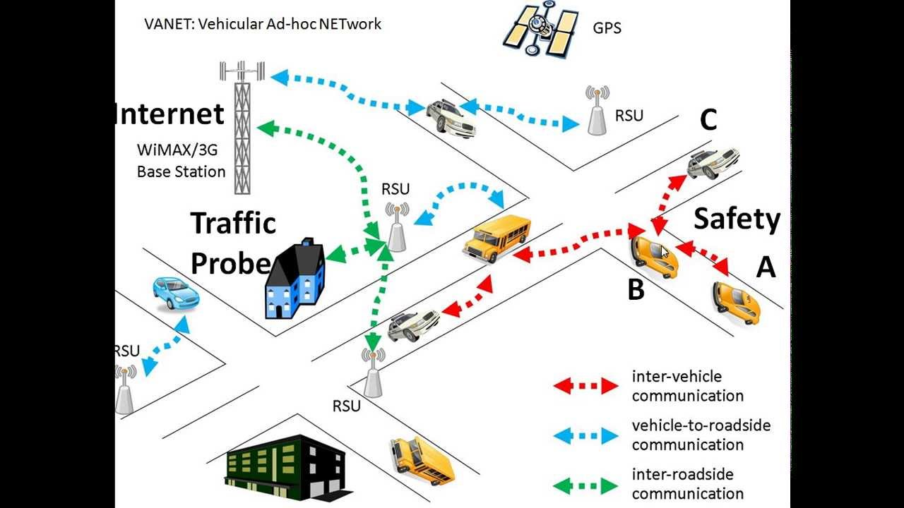
Vehicular Ad-hoc NETwork
Notes:
VANET stands for Vehicular ad hoc network, digital communications between cars and trucks and also roadside units. So here we can communicate between vehicles or V2V Communication even communication between vehicles and roadside units, it could be a grocery store or traffic light anything in the rood. So now there are basically three things that you could do in VANET one of them is safety, safety management and the other one is traffic management who has a big screen and he can see where all the cars are and the third one is internet services like youTube or anything else.

Slide 10
Characteristics of VANET’s
High mobility
Rapidly changing network topology
Unbounded network size
Frequent exchange of information
Time critical
Sufficient energy
Better physical protection

Slide 11
My Current Research Topic
My Current Research Topic
Secure and Efficient Medium Access Control for Multi-Channel V2V communication

Slide 12
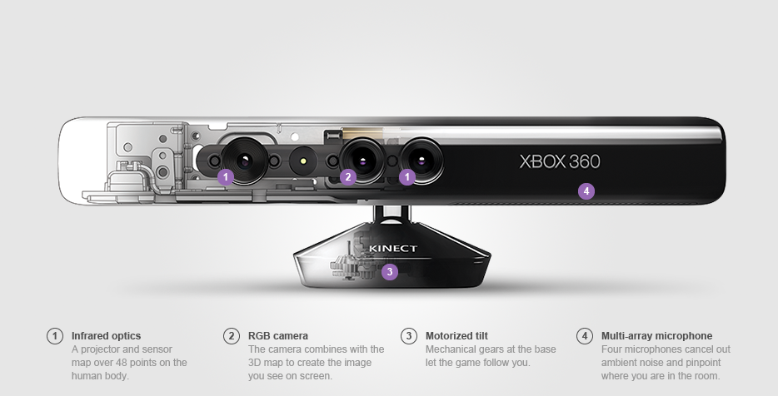
KINECT
Notes:
Today I’m going too show you program that you can use to 3d scan yourself and other objects at home using an XBOXKINECT. Kinect is a motion detecting camera that you can use with the Xbox 360. It uses special technology to track your body movements and translate those movements into games.

Slide 13
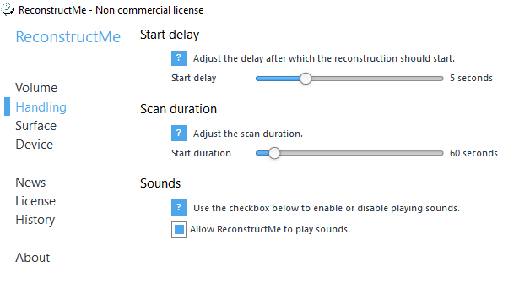
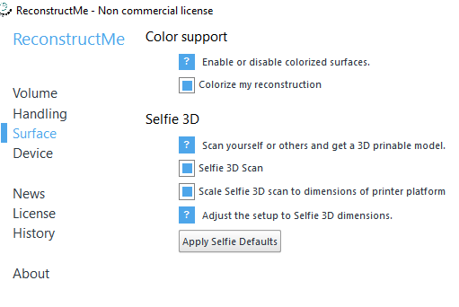
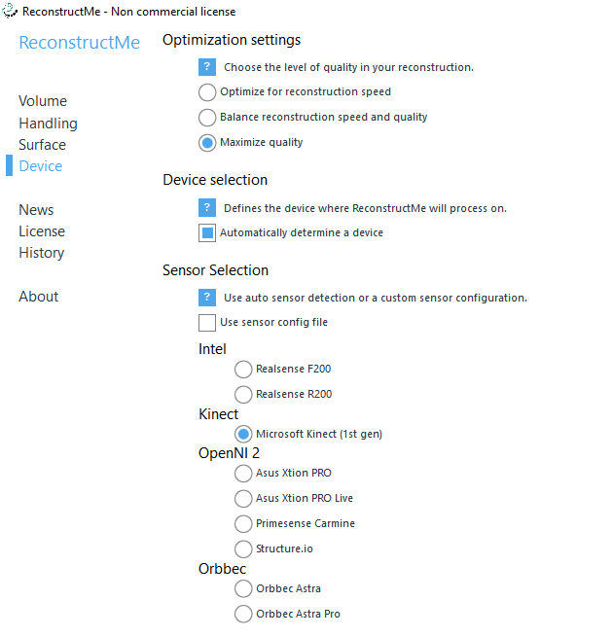
Notes:
This program is ReconstructMe, Whish is developed by a group of computer vision experts at ProFusion company.

Slide 14
ReconstructMe
ReconstructMe’s usage concept is similar to that of an ordinary video camera – simply move around the object to be modelled in 3D.
Scanning with ReconstructMe scales from smaller objects such as human faces up to entire rooms and runs on commodity computer hardware.

Slide 15

How do I create a 3D Selfie?
A selfie is a type of self-portrait photograph, typically taken with a hand-held digital camera or camera phone.
ReconstructMe extends the selfie idea to 3D. Using the self-portrait feature in ReconstructMe, everyone can generate 3D printable busts in a minute.

Slide 16
Considerations for generating selfies
for optimized results.
Ensure you have enough space
Rigidness and constant facial expression
Constant lighting conditions
Camera placement and calibration

Slide 17
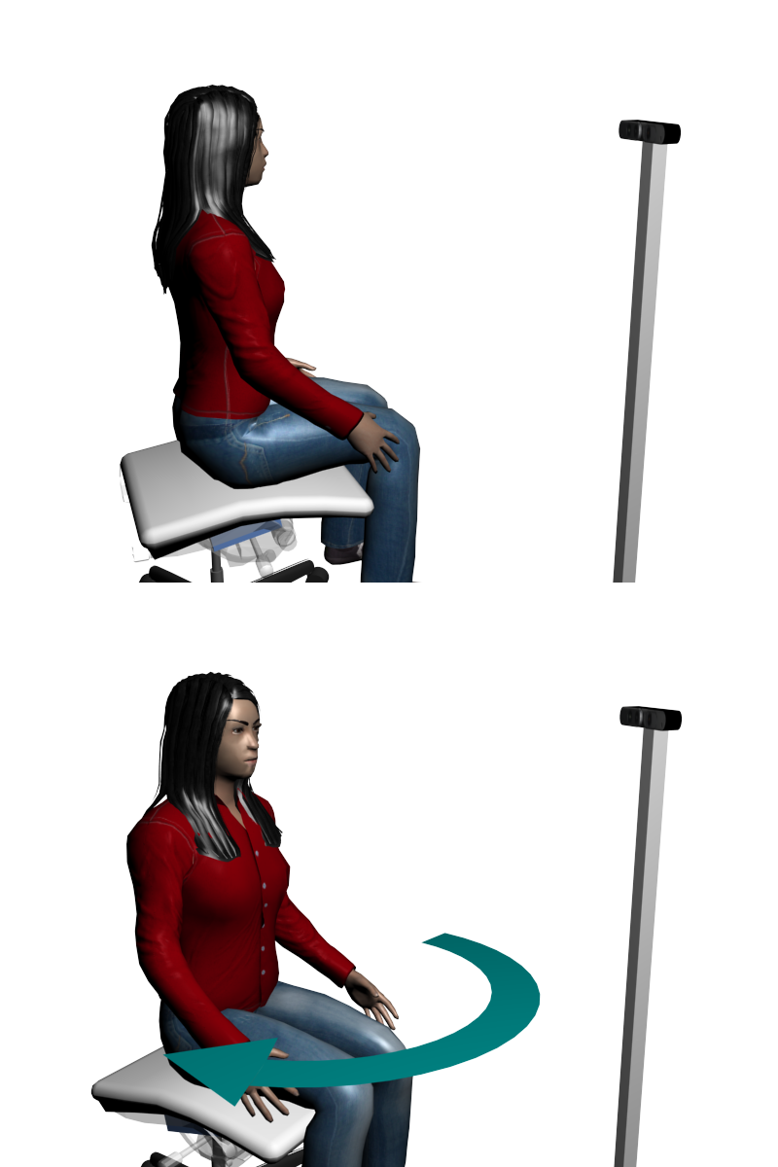
Experiemnt 1: Self Rotation - 3D Selfie

Slide 18
Experiemnt 1: Self Rotation - 3D Selfie
Follow these steps to generate a 3D selfie
Position the camera horizontally and on eye-level height infront of you.
Activate Selfie mode in ReconstructMe’s Surface settings area.
Click Start to begin the selfie scan.
Turn around 360 degrees in either direction – reconstruction will stop automatically.
Wait for the post-processing to complete and save your model.
Your model is now ready to be opened in 3D
printing application.
☺

Slide 19
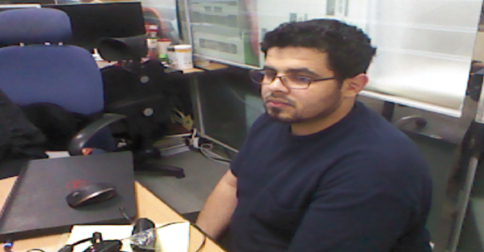
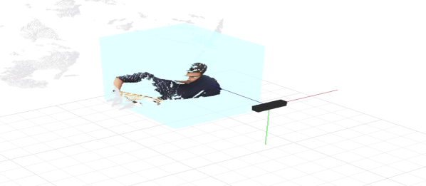
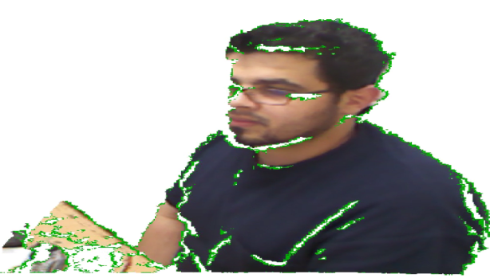

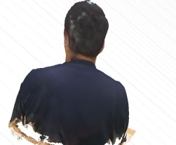
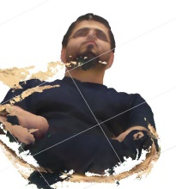
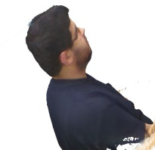
Experiemnt 1: Self Rotation - 3D Selfie
☺

Slide 20

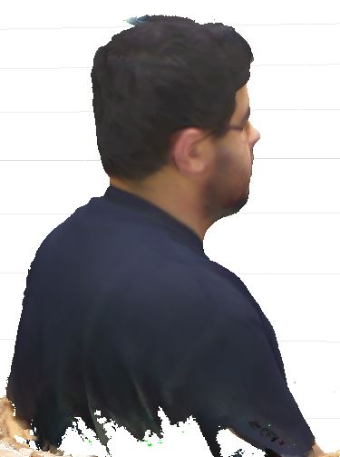
Experiment 1: 3D Output

Slide 21
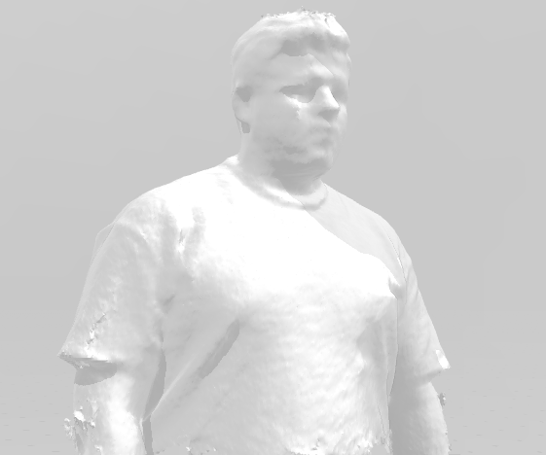
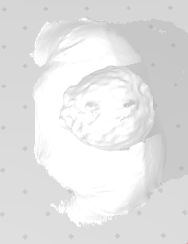
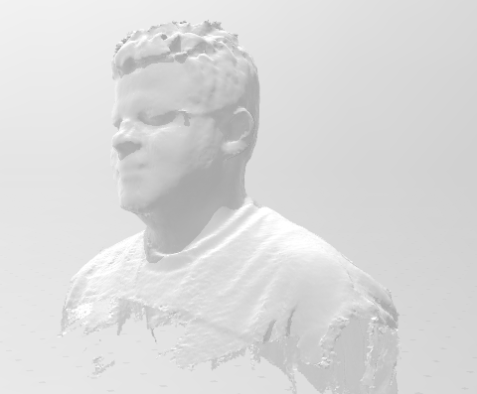
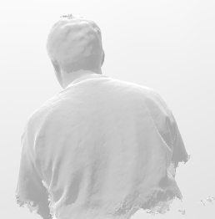
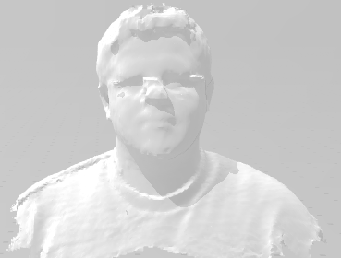
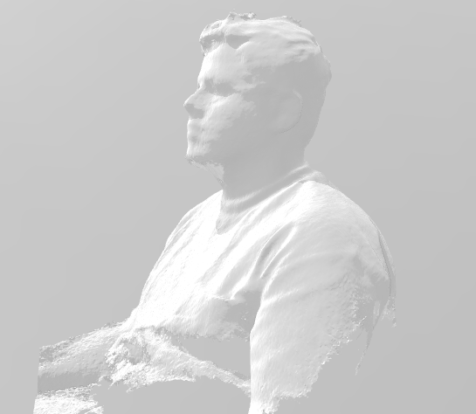
Experiment 1: 3D Output

Slide 22
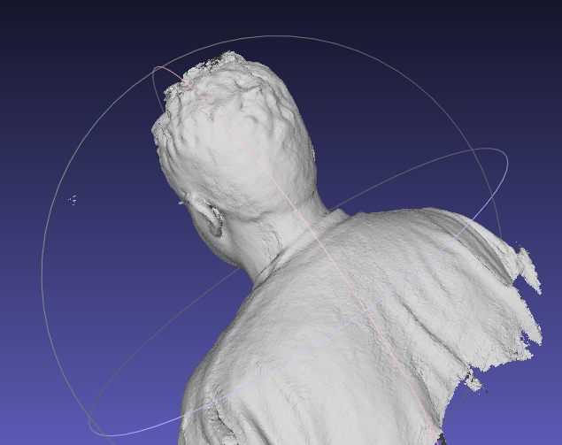
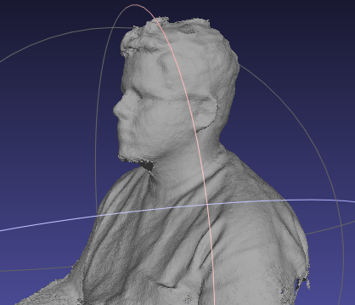
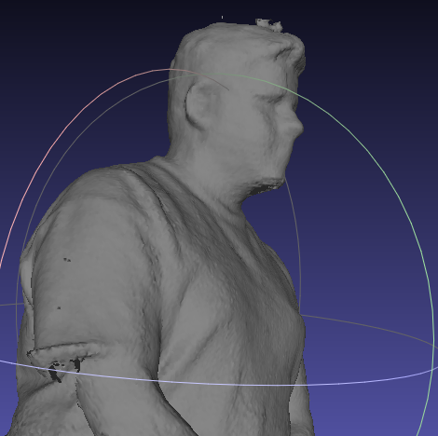
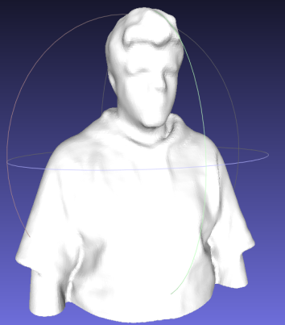
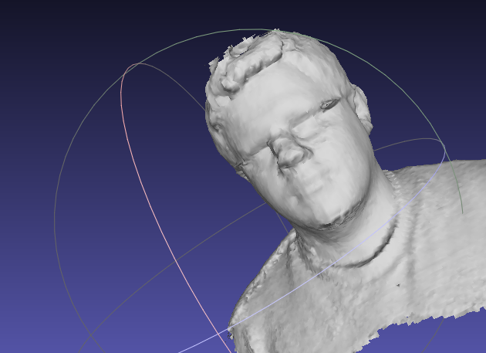
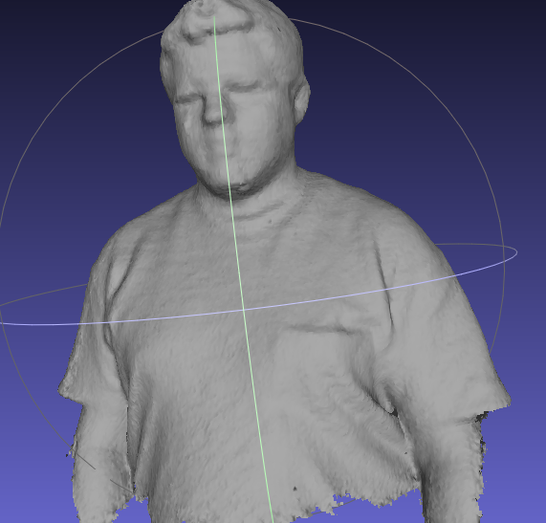
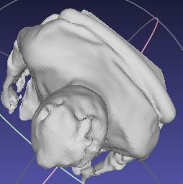
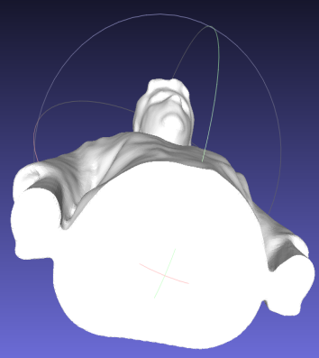
Experiment 1: MashLab 3D Output Cleanup

Slide 23
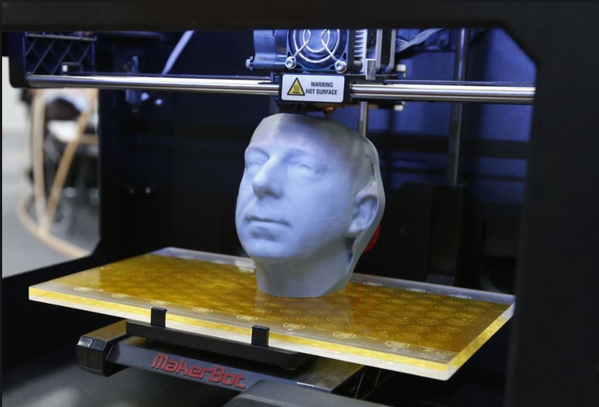
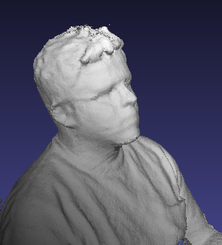
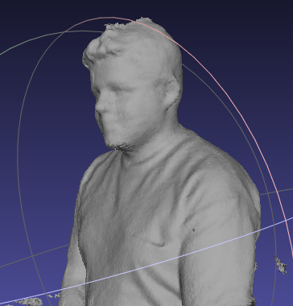
Output 3D Scan Printing

Slide 24
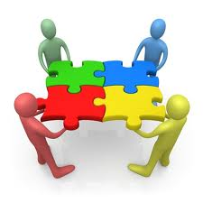
Conclusion
ReconstructMe is a real-time low-cost scanning solution that enables you to quickly digitize your environment. The handling is similar to that of a camcorder. Just move around and watch the reconstruction grow.

Slide 25
Further Reading
Reconstructme Official Website: Reconstructme.net/blog/
How to go from ply reconstructme to solidoodle Forum www.soliforum.com/topic/822/how-to-go-from-ply-reconstructme-to-solidoodle/
Basic Human Scan with Kinect & ReconstructMe Console Forum www.instructables.com/id/Basic-Human-Scan-with-Kinect-ReconstructMe-Conso/

Slide 26


Q & A
Thank You!

Slide 27
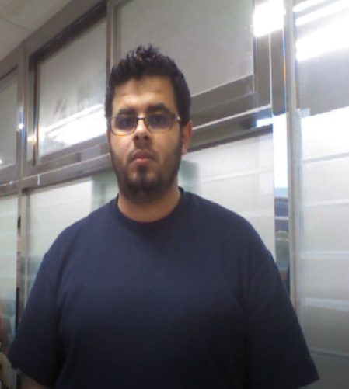
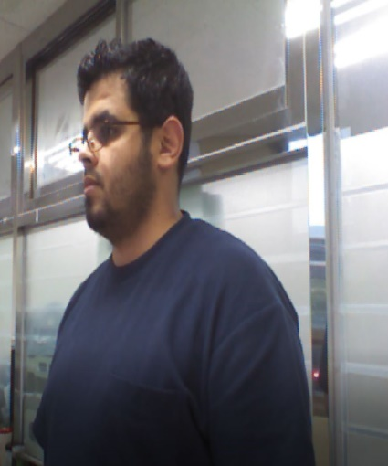
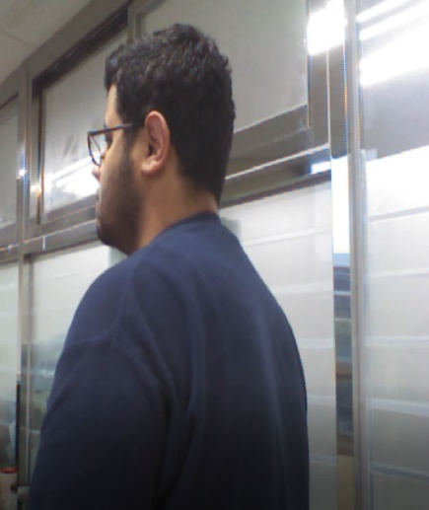
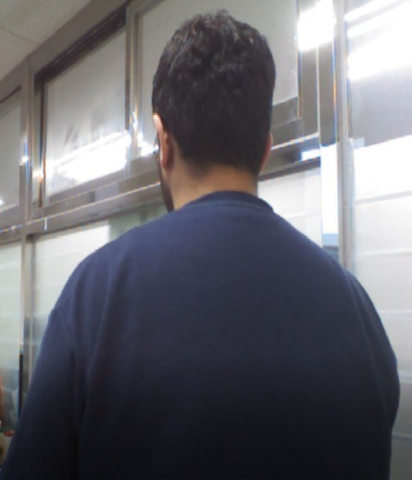
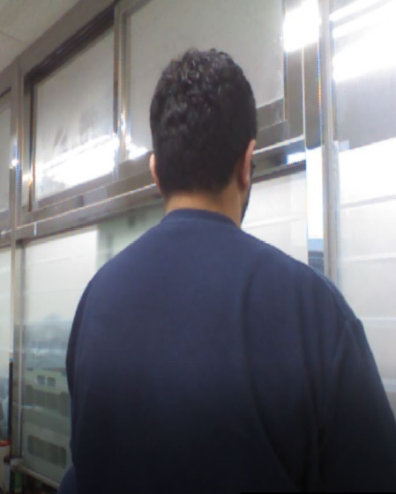
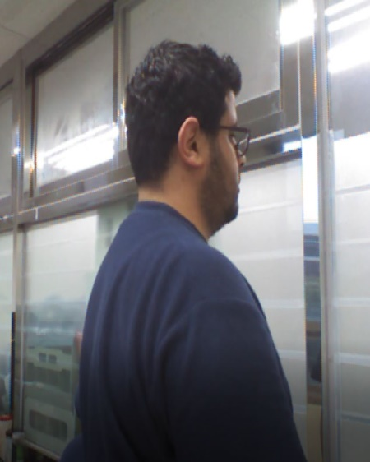
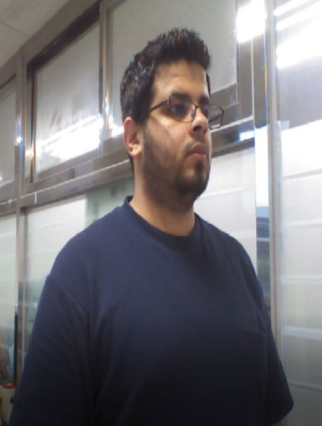
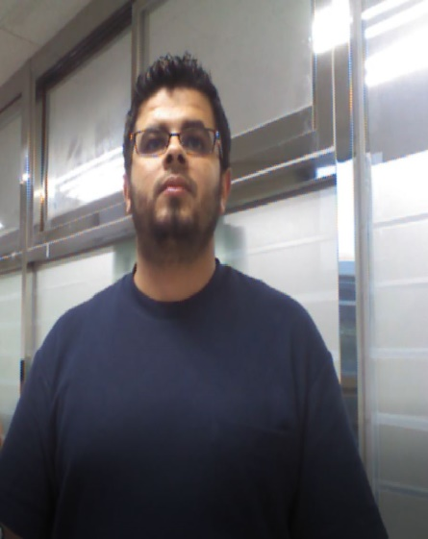
Experiment 2: Kinect Rotation - Room
☺

Slide 28
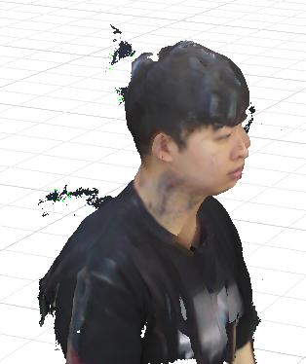

Experiment 2: 3D Output

